Slide 1
Distributed Systems CS 15-440
Caching – Part I
Lecture 20, October 23, 2022
Mohammad Hammoud

Slide 2
Today…
Last Session:
Pregel
Today’s Lecture:
Caching- Part I
Announcements:
PS4 is due today by midnight
P3 is due on Oct 27 by midnight
Quiz II is on Sunday, Oct 30

Slide 3
Latency and Bandwidth
Latency and bandwidth are partially intertwined
If bandwidth is saturated
Congestion occurs and latency increases
If bandwidth is not at peak
Congestion will not occur, but latency will NOT decrease
E.g., Sending a bit on a non-congested 50Mbps medium is not going to be faster than sending 32KB
Bandwidth can be easily increased, but it is inherently hard to decrease latency!

Slide 4
Latency and Bandwidth
In reality, latency is the killer; not bandwidth
Bandwidth can be improved through redundancy
E.g., More pipes, fatter pipes, more lanes on a highway, more clerks at a store, etc.,
It costs money, but not fundamentally difficult
Latency is much harder to improve
Typically, it requires deep structural changes
E.g., Shorten distance, reduce path length, etc.,
How can we reduce latency in distributed systems?

Slide 5
Replication and Caching
One way to reduce latency is to use replication and caching
What is replication?
Replication is the process of maintaining several copies of data at multiple locations
Afterwards, a client can access the replicated copy that is nearest to them, potentially saving latency
What is caching?
Caching is a special kind of client-controlled replication
In particular, client-side replication is referred to as caching

Slide 6

Replication and Caching
Example Applications
Caching webpages at the client browser
Caching IP addresses at clients and DNS Name Servers
Replication in Content Delivery Network (CDNs)
Commonly accessed contents, such as software and streaming media, are cached at various network locations
Main Server
Replicated Servers

Slide 7
Dilemma
CDNs address a major dilemma
Businesses want to know your every click and keystroke
This is to maintain deep, intimate knowledge of clients
Client-side caching hides this knowledge from servers
So, servers mark pages as “uncacheable”
This is often a lie, because the content is actually cacheable
But, the lack of caching hurts latency and subsequently user experience!!
Can businesses benefit from caching without giving up control?

Slide 8
CDNs: A Solution to this Dilemma
Third party caching sites (or providers) provide hosting services, which are trusted by businesses
A provider owns a collection of servers across the Internet
Typically, its hosting service can dynamically replicate files on different servers
E.g., Based on the popularity of a file in a region
Examples:
Akamai (which pioneered CDN in the late 1990s)
Amazon CloudFront CDN
Windows Azure CDN

Slide 9
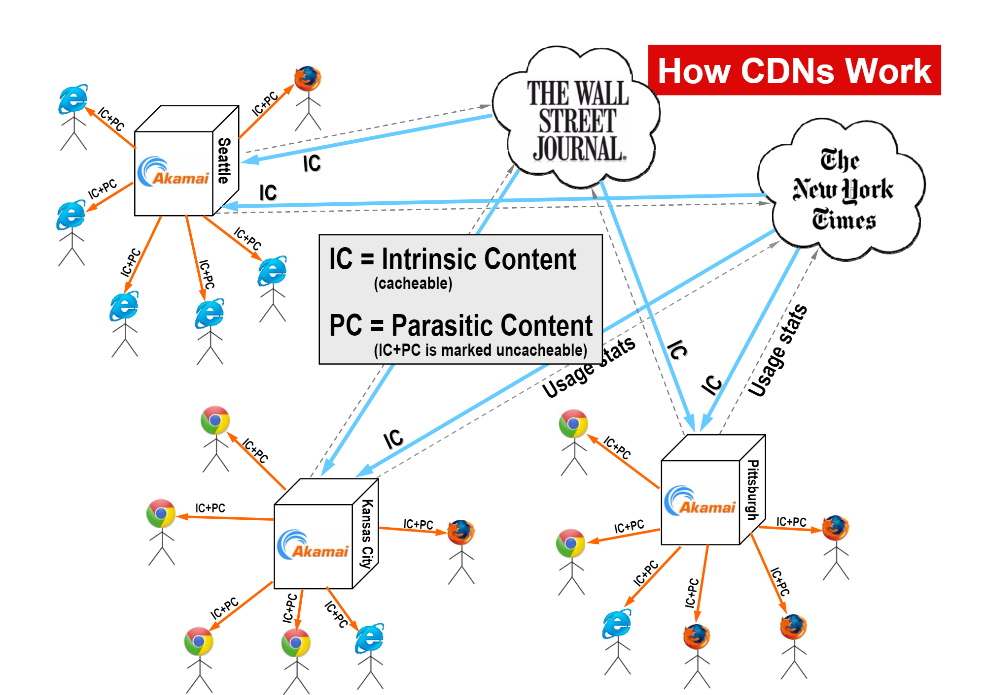
CDNs: A Solution to this Dilemma

Slide 10
Client- vs. Server-side Replication
Would replication (client-side or server-side) help if clients access different data objects?
Yes, through client-side caching
Notes:
A widely held rule of thumb is that a program spends 90% of its execution time in only 10% of the code

Slide 11
Client- vs. Server-side Replication
Would replication (client-side or server-side) help if clients access different data objects?
Yes, through client-side caching
Client 1
Server
O₀
O₁
Client 2
O₂
O₃
Notes:
A widely held rule of thumb is that a program spends 90% of its execution time in only 10% of the code

Slide 12
Client- vs. Server-side Replication
Would replication (client-side or server-side) help if clients access different data objects?
Yes, through client-side caching
Client 1
Server
O₀
O₁
Client 2
O₂
O₃
Notes:
A widely held rule of thumb is that a program spends 90% of its execution time in only 10% of the code

Slide 13
Client- vs. Server-side Replication
Would replication (client-side or server-side) help if clients access different data objects?
Yes, through client-side caching
Client 1
Server
O₀
O₀
O₁
Client 2
O₂
O₃
O₁
Notes:
A widely held rule of thumb is that a program spends 90% of its execution time in only 10% of the code

Slide 14
Client- vs. Server-side Replication
Would replication (client-side or server-side) help if clients access different data objects?
Yes, through client-side caching
Client 1
Server
O₀
O₀
O₁
Client 2
O₂
O₃
O₁
Notes:
A widely held rule of thumb is that a program spends 90% of its execution time in only 10% of the code

Slide 15
Client- vs. Server-side Replication
Would replication (client-side or server-side) help if clients perform requests to the same data objects?
Yes, through server-side replication
Notes:
A widely held rule of thumb is that a program spends 90% of its execution time in only 10% of the code

Slide 16
Client- vs. Server-side Replication
Would replication (client-side or server-side) help if clients perform requests to the same data objects?
Yes, through server-side replication
Client 1
Server
O₀
O₁
Client 2
O₂
O₃
Proxy
Notes:
A widely held rule of thumb is that a program spends 90% of its execution time in only 10% of the code

Slide 17
Client- vs. Server-side Replication
Would replication (client-side or server-side) help if clients perform requests to the same data objects?
Yes, through server-side replication
Client 1
Server
O₀
O₁
Client 2
O₂
O₃
Proxy
Notes:
A widely held rule of thumb is that a program spends 90% of its execution time in only 10% of the code

Slide 18
Client- vs. Server-side Replication
Would replication (client-side or server-side) help if clients perform requests to the same data objects?
Yes, through server-side replication
Client 1
Server
O₀
O₁
Client 2
O₂
O₃
Proxy
Notes:
A widely held rule of thumb is that a program spends 90% of its execution time in only 10% of the code

Slide 19
Client- vs. Server-side Replication
Would replication (client-side or server-side) help if clients perform requests to the same data objects?
Yes, through server-side replication
Client 1
Server
O₀
O₀
O₁
Client 2
O₂
O₃
Proxy
Notes:
A widely held rule of thumb is that a program spends 90% of its execution time in only 10% of the code

Slide 20
Client- vs. Server-side Replication
Would replication (client-side or server-side) help if clients perform requests to the same data objects?
Yes, through server-side replication
Client 1
Server
O₀
O₀
O₁
Client 2
O₂
O₃
Proxy
Notes:
A widely held rule of thumb is that a program spends 90% of its execution time in only 10% of the code

Slide 21
Client- vs. Server-side Replication
Would replication (client-side or server-side) help if clients perform requests to the same data objects?
Yes, through server-side replication
Client 1
Server
O₀
O₀
O₁
Client 2
O₂
O₃
Proxy
Notes:
A widely held rule of thumb is that a program spends 90% of its execution time in only 10% of the code

Slide 22
Client- vs. Server-side Replication
Would replication (client-side or server-side) help if clients perform requests to the same data objects?
Yes, through server-side replication
Client 1
Server
O₀
O₀
O₁
Client 2
O₂
O₃
Proxy
Notes:
A widely held rule of thumb is that a program spends 90% of its execution time in only 10% of the code

Slide 23
Client- vs. Server-side Replication
Would replication (client-side or server-side) help if clients perform requests to the same data objects?
Yes, through server-side replication
Client 1
Server
O₀
O₀
O₁
Client 2
O₂
O₃
Proxy
Notes:
A widely held rule of thumb is that a program spends 90% of its execution time in only 10% of the code

Slide 24
Client- vs. Server-side Replication
Would replication (client-side or server-side) help if clients perform requests to the same data objects?
Yes, through server-side replication
Client 1
Server
O₀
O₀
O₁
Client 2
O₂
O₃
Proxy
Notes:
A widely held rule of thumb is that a program spends 90% of its execution time in only 10% of the code

Slide 25
Client- vs. Server-side Replication
Would replication (client-side or server-side) help if clients perform requests to the same data objects?
Yes, through server-side replication
Client 1
Server
O₀
O₀
O₁
Client 2
O₂
O₃
Proxy
Notes:
A widely held rule of thumb is that a program spends 90% of its execution time in only 10% of the code

Slide 26
Client- vs. Server-side Replication
Would combined client- and server-side replication help if clients perform requests to the same data objects?
Yes
Notes:
A widely held rule of thumb is that a program spends 90% of its execution time in only 10% of the code

Slide 27
Client- vs. Server-side Replication
Would combined client- and server-side replication help if clients perform requests to the same data objects?
Yes
Client 1
Server
O₀
O₀
O₁
Client 2
O₂
O₃
Proxy
Notes:
A widely held rule of thumb is that a program spends 90% of its execution time in only 10% of the code

Slide 28
Client- vs. Server-side Replication
Would combined client- and server-side replication help if clients perform requests to the same data objects?
Yes
Client 1
Server
O₀
O₀
O₀
O₁
Client 2
O₂
O₃
Proxy
O₀
Notes:
A widely held rule of thumb is that a program spends 90% of its execution time in only 10% of the code

Slide 29
Caching
We will focus first on caching then replication
The basic idea of caching (it is very simple):
A data object is stored far away
A client needs to make multiple references to that object
A copy (or a replica) of that object can be created and stored nearby
The client can transparently access the replica instead
Local storage used for client-side replicas is referred to as “cache”

Slide 30
Three Key Questions
What data should be cached and when?
Fetching Policy
How can updates be made visible everywhere?
Consistency or Update Propagation Policy
What data should be evicted to free up space?
Cache Replacement Policy

Slide 31
Three Key Questions
What data should be cached and when?
Fetching Policy
How can updates be made visible everywhere?
Consistency or Update Propagation Policy
What data should be evicted to free up space?
Cache Replacement Policy

Slide 32
Fetching Policy
Two broad types:
Push-based fetching policy
Pull-based fetching policy

Slide 33
Push-Based Caching
Push-based Caching (or Full Replication)
Every participating machine gets a complete copy of data in advance
Every new file gets pushed to all participating machines
Every update on a file is pushed immediately to every corresponding replica
Example: Dropbox
Works well enough in practice (technical excellence is only weakly correlated to business success)

Slide 34
Push-Based Caching: Scalability Issues
Clearly, this can create a major scalability issue
With larger team sizes and/or datasets, the push-based model consumes larger amounts of network bandwidth and disk spaces
At very large-scale, it might take a day to finish a sync operation!
This defeats the very purpose of full replication, which is usually to enable collaboration among teams
A different approach referred to as pull-based caching attempts to solve this problem

Slide 35
Pull-Based Caching
Pull-based Caching (or On-demand Caching)
A file is fetched only if needed
Updates on a file (not necessarily the whole file) are propagated to replicated files only if needed
This leads to a more fine-grained and selective approach (as opposed to the push-based model) for data management
Examples: AFS

Slide 36
Three Key Questions
What data should be cached and when?
Fetching Policy
How can updates be made visible everywhere?
Consistency or Update Propagation Policy
What data should be evicted to free up space?
Cache Replacement Policy

Slide 37
One-Copy Semantic
Caching Reality
Desired Illusion
One-Copy Semantic

Slide 38
One-Copy Semantic
A caching system has one-copy semantic if and only if:
There are no externally observable functional differences with respect to an equivalent system that does no caching
However, performance/timing differences may be visible
This is very difficult to achieve in practice
Except in very narrow circumstances like HPC-oriented file systems and DSMs
All real implementations are approximations

Slide 39
Cache Consistency Approaches
We will study 7 cache consistency approaches:
Broadcast Invalidations
Check on Use
Callback
Leases
Skip Scary Parts
Faith-Based Caching
Pass the Buck

Slide 40
Cache Consistency Approaches
We will study 7 cache consistency approaches:
Broadcast Invalidations
Check on Use
Callback
Leases
Skip Scary Parts
Faith-Based Caching
Pass the Buck

Slide 41

Broadcast Invalidations
A write goes as follows:
Reads on cached objects can proceed directly
(F1, F2, F3)
Server
Need to Write on F1
Go Ahead
Write-
back F1
Invalidate F1
(F1)
Client 1
Ack
Write on F1
(F2)
(F1, F2)
Client 2
(F3)
Negative-Ack
Client 3

Slide 42
Broadcast Invalidations
The server does not maintain a directory that keeps track of who is currently caching every object
Thus, upon any update to any object, the server broadcasts an invalidation message to every caching site
If a site is caching the object, it invalidates it; otherwise, it sends a negative Ack message to the server
If invalidated, next reference to this object at this site will cause a miss

Slide 43
Broadcast Invalidations
Advantages:
No special state (except locations of caching sites) is maintained at the server
A stateless server
No race conditions can occur if an updater blocks until all the cached copies of the requested object (except its own) are invalidated
Very strict emulation of the one-copy semantic
Simple to implement

Slide 44
Broadcast Invalidations
Disadvantages:
Traffic is wasted, especially if no site caches the requested object
The updater blocks until the invalidation process is completed
Not scalable in large networks
Could lead to flooding the network if the number of writes is high and the read/write ratio is low
Requires that all sites listen (or snoop) to all requests

Slide 45
Cache Consistency Approaches
We will study 7 cache consistency approaches:
Broadcast Invalidations
Check on Use
Callback
Leases
Skip Scary Parts
Faith-Based Caching
Pass the Buck

Slide 46
Check on Use
The server does not invalidate cached copies upon updates
Rather, a requestor at any site checks with the server before using any object
Versioning can be used, wherein each copy of a file is given a version number
Is my copy still valid?
If no, fetch a new copy of the object
If yes and I am a reader, proceed
If yes and I am a writer, proceed and write-back when done

Slide 47
Check on Use
Has to be done at coarse-granularity (e.g., entire file or large blocks)
Otherwise, reads are slowed down excessively
It results in session semantic if done at whole file granularity
Open {Read | Write}* Close ➔ “session”
Updates on an open file are initially visible only to the updater of the file
Only when the file is closed, the changes are made visible to the server

Slide 48
Check on Use
Disadvantages:
“Up-to-date” is relative to network latency
Server
(F)
Is version of file F
still X?
YES
YES
(F)
Write-Back
Client 1
Update
Is version of file F
still X?
Write-Back
Client 2
(F)
Update
Concurrent Updates!

Slide 49
Check on Use
Disadvantages:
How to handle concurrent writes?
The final result depends on whose write-back arrives last at the server
This gets impacted by network latency
If updates A and B are exactly the same
And the machines where they are pursued are homogenous
And A is started, finished, and sent before B
It is not necessary that A will reach the server before B
Slow reads
Especially with loaded servers and high-latency networks

Slide 50
Check on Use
Disadvantages:
Pessimistic approach, especially with read-most workloads
Can we employ an optimistic (or Trust-and-Verify) approach?
Advantages:
Strict consistency (not across all copies) at coarse granularity
No special server state is needed
Servers do not need to know anything about caching sites
Easy to implement

Slide 51
Cache Consistency Approaches
We will study 7 cache consistency approaches:
Broadcast Invalidations
Check on Use
Callback
Leases
Skip Scary Parts
Faith-Based Caching
Pass the Buck

Slide 52
Callback
A write goes as follows:
Reads on cached objects can proceed directly
(F1, F2, F3)
Server
Need to Write on F1
Go
Ahead
Write-
back F1
Invalidate F1
(F1)
Client 1
Ack
Write on F1
(F1, F2)
(F2)
Client 2
(F3)
Client 3

Slide 53
Callback
The server maintains a directory that keeps track of who is currently caching every object
Thus, upon an update to an object, the server sends invalidation messages (i.e., or callbacks) only to sites that are currently caching the object
Typically done at coarse granularity (e.g., entire file)
Can be made to work with byte ranges

Slide 54
Callback
Advantages:
Targeted notification of caching sites
Zero network traffic for reads of cached objects
Biases read performance in favor of write-performance
Excellent scalability, especially with read-most workloads

Slide 55
Callback
Disadvantages:
Complexity of tracking cached objects on clients
Sizable state on server
Silence at the server is ambiguous for clients
What if a client has been reading a file for a little while without hearing back from the server?
Perhaps the server is down
A keep-alive (or heartbeat) mechanism can be incorporated, whereby the server pings the clients (or the other way around) every now and then indicating that he is still alive

Slide 56
Next Class…
Continue on cache consistency approaches

